Slide 1
Connecting to a database in JBOSS EAP

Slide 2
Understanding few terminologies
Database is a collection of data mostly in the form of tables (rows and columns)
Datasource is a connection between the JBOSS EAP and the database
The Postgresql database is chosen for the purpose of demo
https://www.postgresql.org/download/ (You can use this link to download and install postgresql)
Database driver acts as an interface to connect to the database
can be downloaded from the link mentioned in the next slide
Data source definition
Set of attributes that define a database connection

Slide 3
Driver download link
Vendor | Download Location
MySQL | http://www.mysql.com/products/connector/
PostgreSQL | http://jdbc.postgresql.org/
Oracle | http://www.oracle.com/technetwork/database/features/jdbc/index-091264.html
IBM | http://www-306.ibm.com/software/data/db2/java/
Sybase | The jConnect JDBC driver is part of the SDK for SAP ASE installation. Currently there is not a separate download site for this driver by itself.
Microsoft | http://msdn.microsoft.com/data/jdbc/

Slide 4
Steps involved
Install postgresql and create a database called as Student with the table called as Score
Download the database driver for Postgresql
Install the drive using the CLI
deploy fullpathjarname.jar
Create the datasource (and use the driver name) using management console
Test the connection
Use a existing database project to connect to the database that we have created

Slide 5
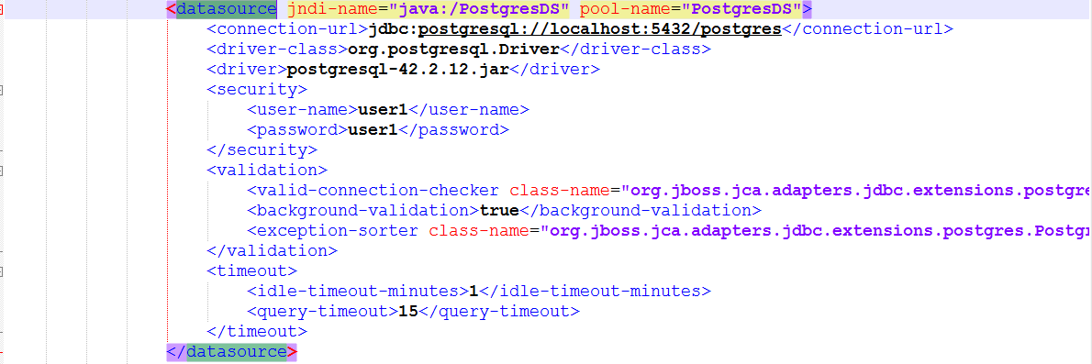
Data source definition

Slide 6
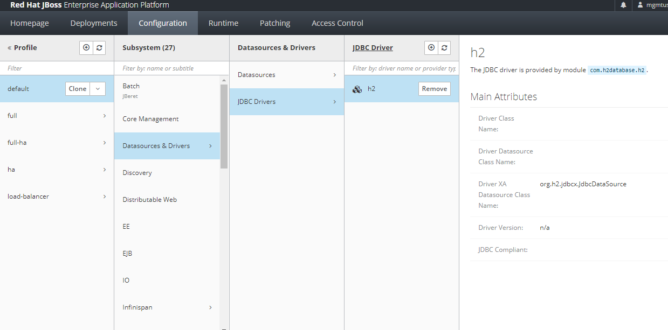
Adding a Datasource

Slide 7
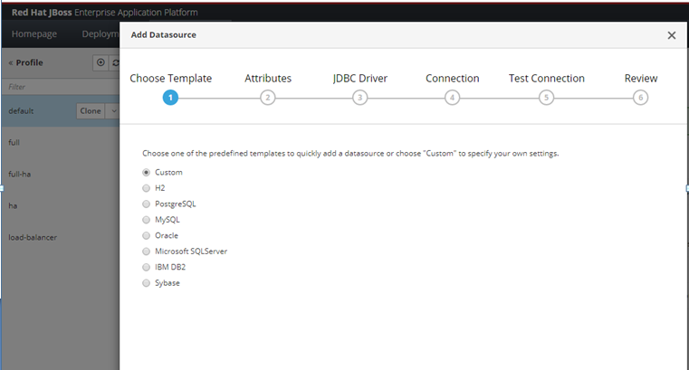
Selecting the database

Slide 8
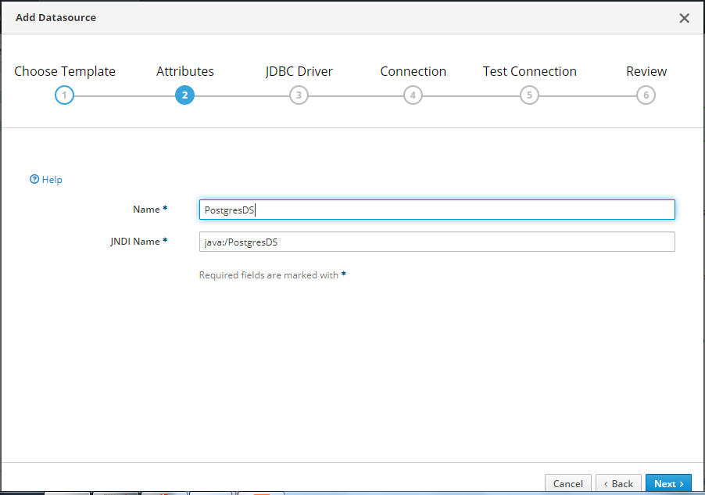
Adding a name to the datasource

Slide 9
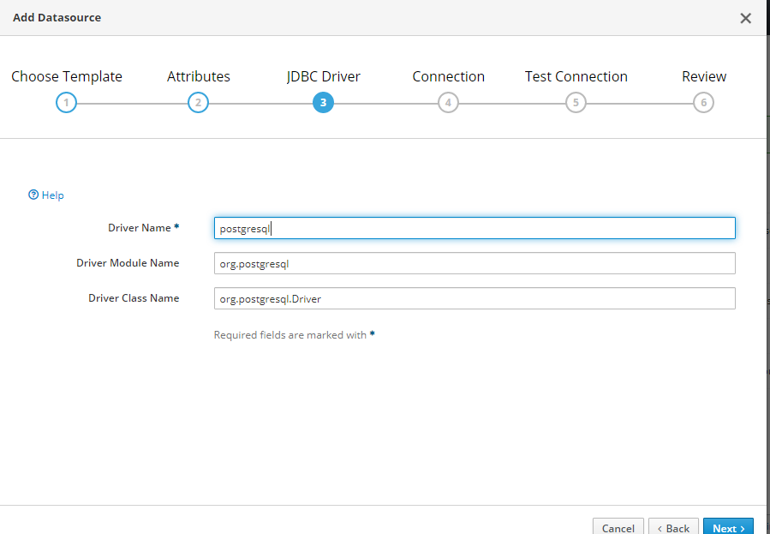
Adding the database driver

Slide 10
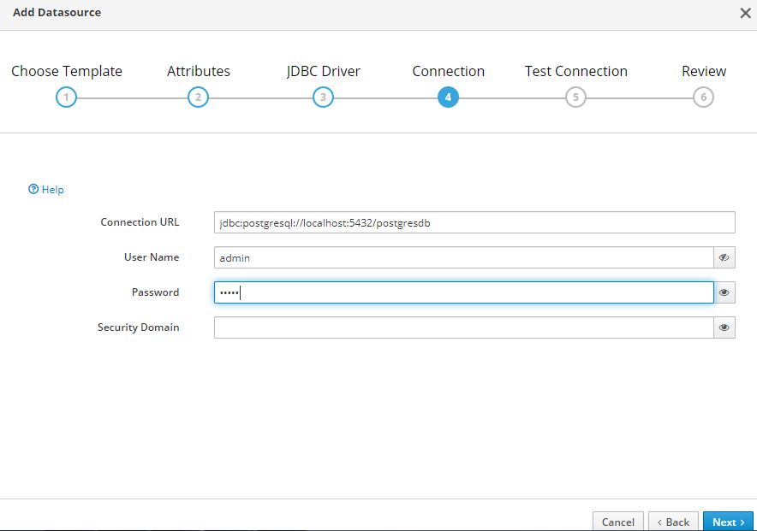
Connection URL

Slide 11
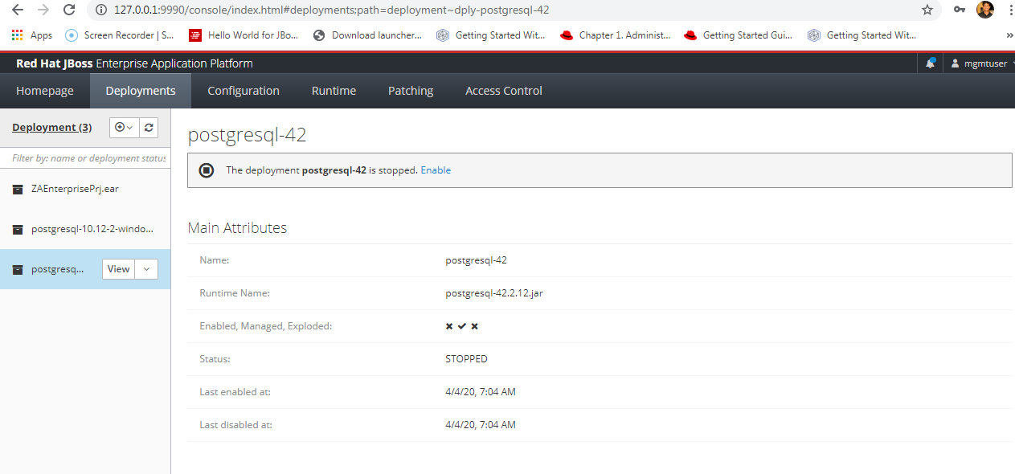
Uploading the jar

Slide 12
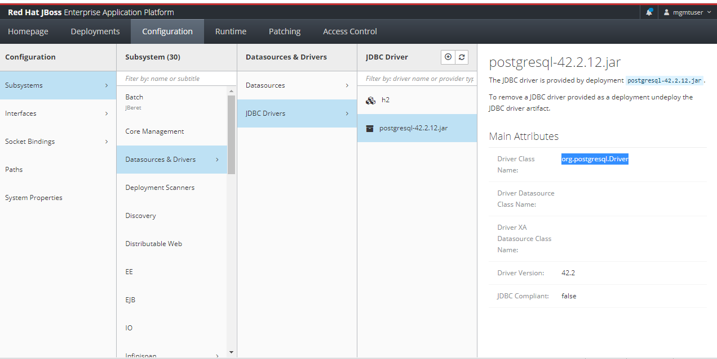
Step 2 is installing the jar

Slide 13
